Slide 1
Model Specification
Part 1
BUAN / MECO 6312
Dr. Moran Blueshtein
University of Texas - Dallas

Slide 2
Model Specification
In any econometric investigation, the choice of the model is the most important decision you will have to make
What are the important considerations when choosing a model?
What are the consequences of choosing the wrong model
Are there ways of assessing whether a model is adequate?

Slide 3
Omitted and Irrelevant Variables

Slide 4
Model Specification
Omitted Variables
It is possible that a chosen model may have important variables omitted
We may have overlooked a variable, or lack of data may lead us to drop a variable even when it is prescribed by economic theory

Slide 5
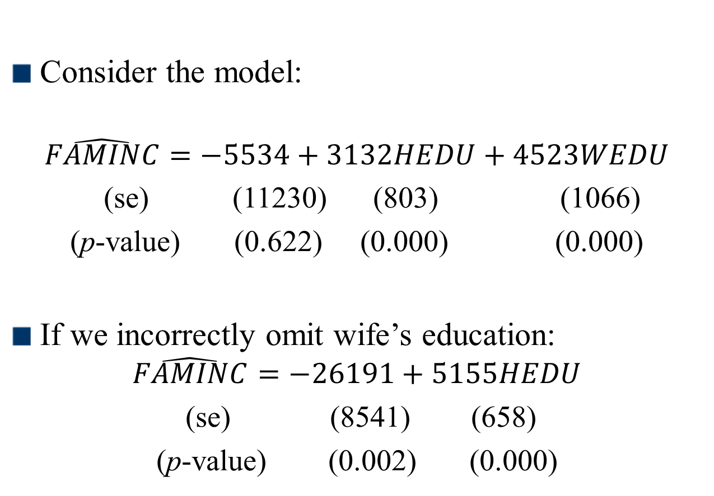
Model Specification
Omitted Variables
Consider the model:
$$\hat{FAMINC}=−5534+3132HEDU+4523WEDU$$ (se) (11230) (803) (1066)
(p-value) (0.622) (0.000) (0.000)
If we incorrectly omit wife’s education:
$$\hat{FAMINC}=−26191+5155HEDU$$
(se) (8541) (658)
(p-value) (0.002) (0.000)

Slide 6
Model Specification
Omitted Variables
omitting WEDU leads us to overstate the effect of an extra year of education for the husband by about $2,000
Omission of a relevant variable leads to an estimator that is biased
This bias is known as omitted-variable bias
Why?

Slide 7
Omitted-Variable Bias: A Proof
Consider the model:
Now suppose we incorrectly omit x_{i3} and estimate:
Notice the new error term is now:

Slide 8
Omitted-Variable Bias: A Proof
The estimator for β₂ is:
where

Slide 9
Omitted-Variable Bias: A Proof
Substituting for v_{i} yields:
where

Slide 10
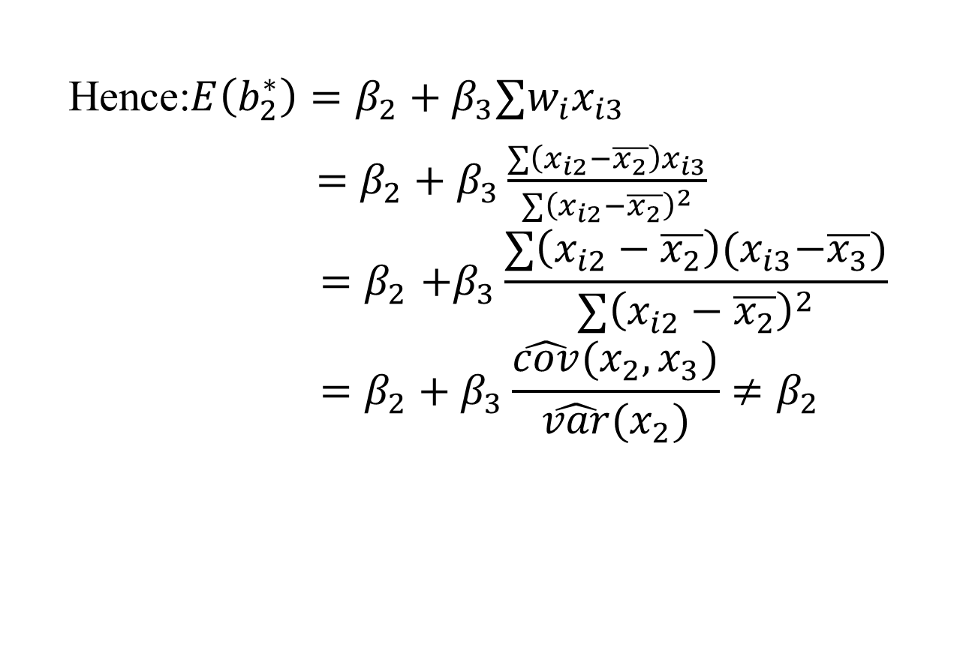
Omitted-Variable Bias: A Proof
Hence:$E\left(b_{2}^{∗}\right)=β_{2}+β_{3}∑w_{i}x_{i3}$
$=β_{2}+β_{3}\frac{∑\left(x_{i2}−\overline{x_{2}}\right)x_{i3}}{∑{\left(x_{i2}−\overline{x_{2}}\right)}^{2}}$ $${=β}_{2}+β_{3}\frac{∑\left(x_{i2}−\overline{x_{2}}\right){(x}_{i3}−\overline{x_{3}})}{∑{\left(x_{i2}−\overline{x_{2}}\right)}^{2}} \\ =β_{2}+β_{3}\frac{\hat{cov}(x_{2},x_{3})}{\hat{var}(x_{2})}≠β_{2}$$

Slide 11

Model Specification
Omitted Variables
The bias is:
$$bias\left(b_{2}^{∗}\right)=E\left(b_{2}^{∗}\right)−β_{2}=β_{3}\frac{\hat{cov}(x_{2},x_{3})}{\hat{var}\left(x_{2}\right)}$$

Slide 12
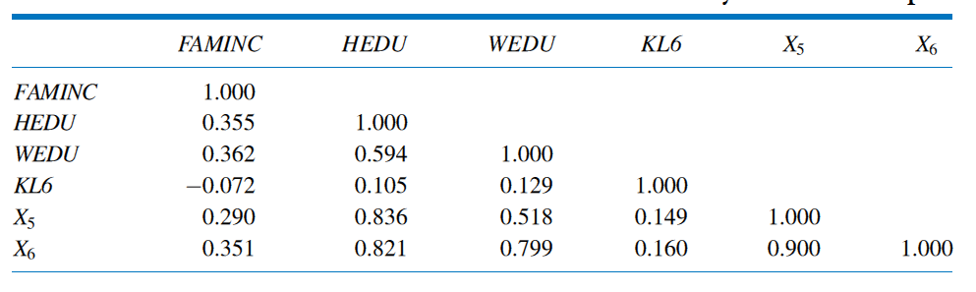
Model Specification
Correlation Matrix for Variables Used in Family Income Example
Omitted Variables

Slide 13
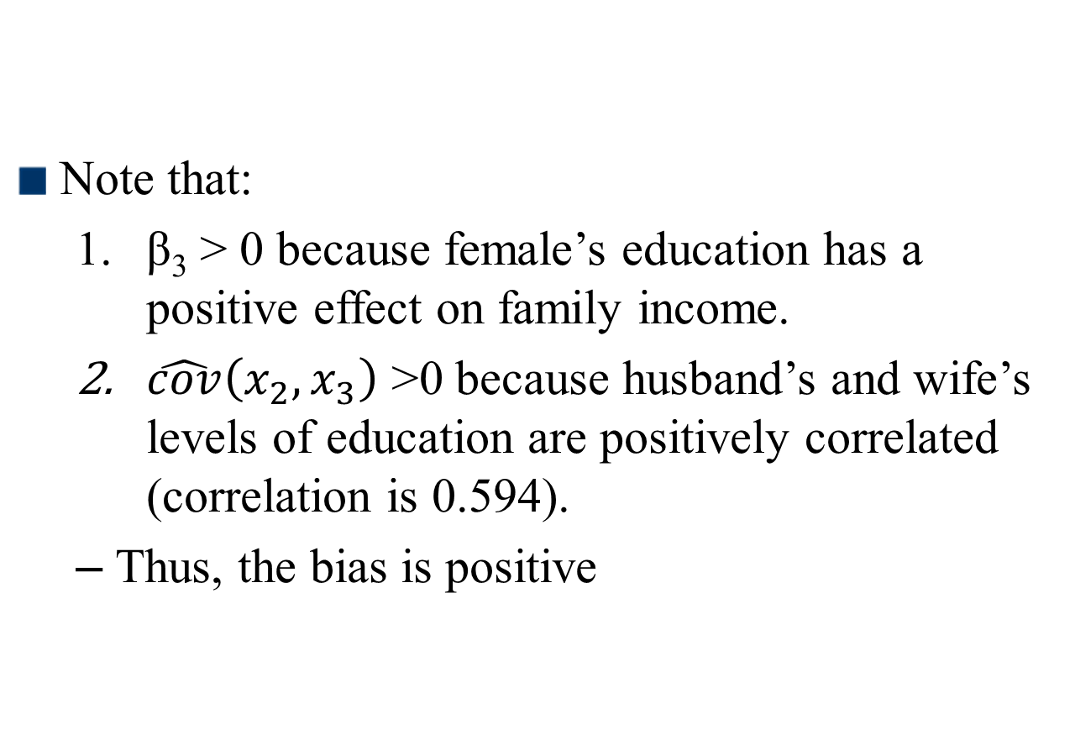
Model Specification
Omitted Variables
Note that:
β₃ > 0 because female’s education has a positive effect on family income.
$\hat{cov}\left(x_{2},x_{3}\right)$ >0 because husband’s and wife’s levels of education are positively correlated (correlation is 0.594).
Thus, the bias is positive

Slide 14
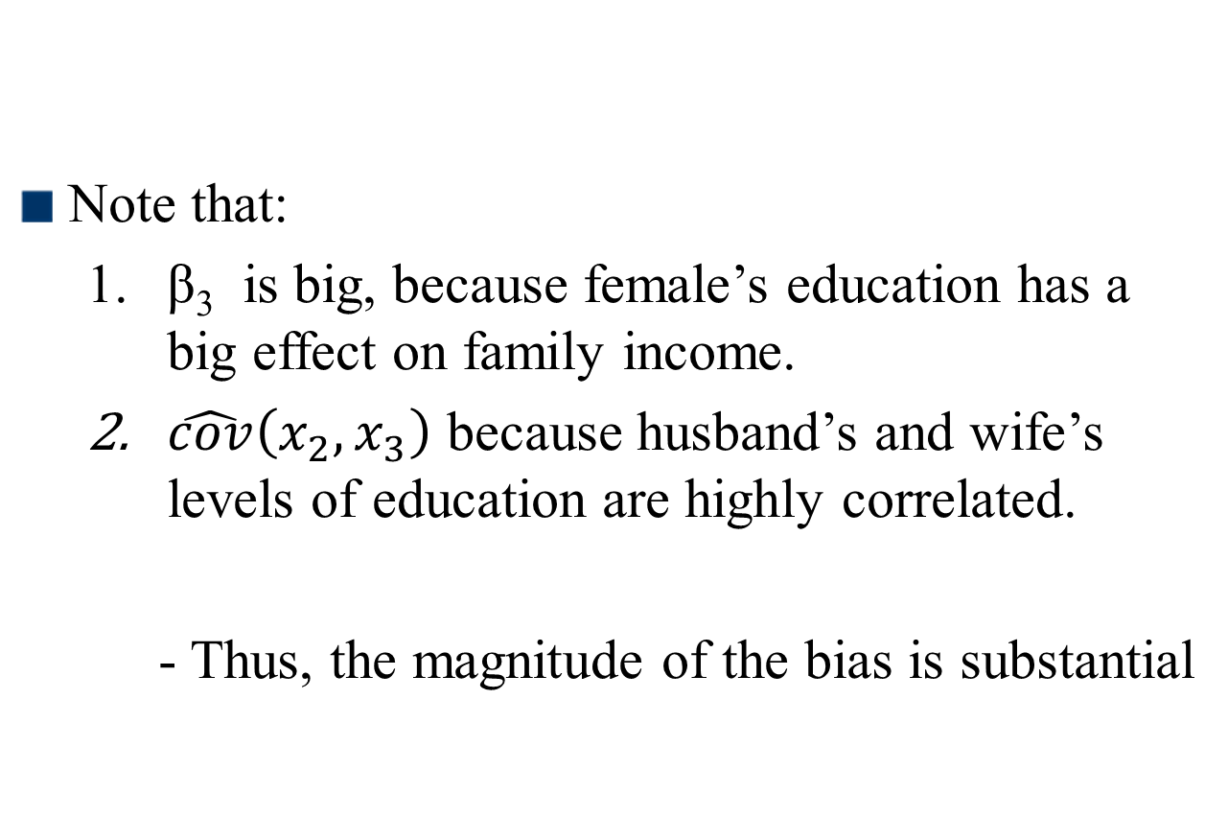
Model Specification
Omitted Variables
Note that:
β₃ is big, because female’s education has a big effect on family income.
$\hat{cov}\left(x_{2},x_{3}\right)$ because husband’s and wife’s levels of education are highly correlated.
- Thus, the magnitude of the bias is substantial

Slide 15
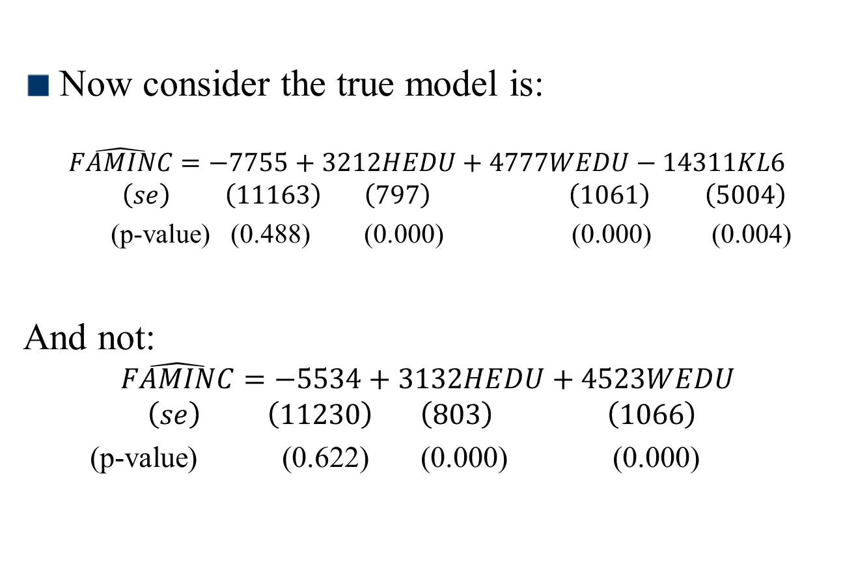
Model Specification
Omitted Variables
Now consider the true model is:
$$\hat{FAMINC}=−7755+3212HEDU+4777WEDU−14311KL6 \\ \left(se\right) \left(11163\right) \left(797\right) \left(1061\right) \left(5004\right)$$
(p-value) (0.488) (0.000) (0.000) (0.004)
And not: $$\hat{FAMINC}=−5534+3132HEDU+4523WEDU \\ \left(se\right) \left(11230\right) \left(803\right) \left(1066\right)$$
(p-value) (0.622) (0.000) (0.000)

Slide 16
Model Specification
Correlation Matrix for Variables Used in Family Income Example
Omitted Variables

Slide 17
Model Specification
Omitted Variables
Notice that the coefficient estimates for HEDU and WEDU have not changed a great deal
This outcome occurs because KL6 (# of kids less than 6) is not highly correlated with the education variables.
We should be more concerned regarding omitting highly correlated data.

Slide 18
Model Specification
Irrelevant Variables
Is this a good strategy to include as many variables as possible in your model?
Doing so will not only complicate your model unnecessarily, but may also inflate the variances of your estimates because of the presence of irrelevant variables. However the estimators are still unbiased.

Slide 19
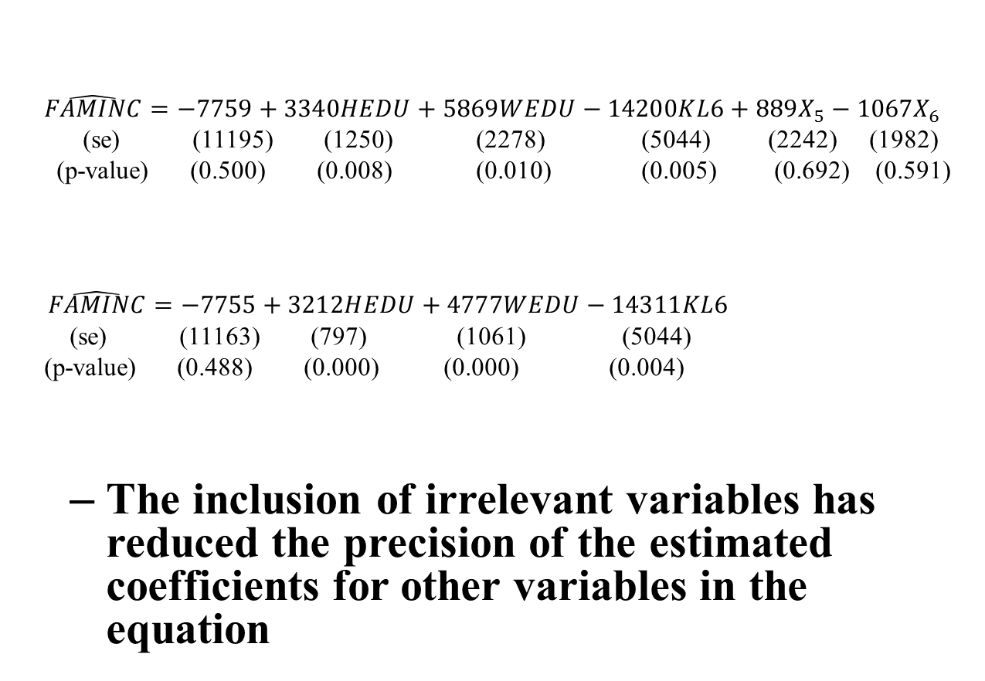
Model Specification
Irrelevant Variables
$$\hat{FAMINC}=−7759+3340HEDU+5869WEDU−14200KL6+889X_{5}−1067X_{6}$$
(se) (11195) (1250) (2278) (5044) (2242) (1982)
(p-value) (0.500) (0.008) (0.010) (0.005) (0.692) (0.591)
$\hat{FAMINC}=−7755+3212HEDU+4777WEDU−14311KL6$
(se) (11163) (797) (1061) (5044)
(p-value) (0.488) (0.000) (0.000) (0.004)
The inclusion of irrelevant variables has reduced the precision of the estimated coefficients for other variables in the equation

Slide 20
Model Specification
Correlation Matrix for Variables Used in Family Income Example
Omitted Variables

